Slide 1
Propositional Logic
Artificial Intelligence

Slide 2
Knowledge Representation and Reasoning
Perceiving, that is, acquiring information from environment,
Knowledge Representation, that is, representing its understanding of the world,
Reasoning, is the use of symbolic representations of some statements in order to derive new ones
Predicate logic is the generic term for symbolic formal systems like first-order logic, second-order logic, many-sorted logic, or infinitary logic.
The logical language, in turn, has two aspects,
Syntax
Semantics

Slide 3
Knowledge Representation and Reasoning
Syntax: Syntax specifies the symbols in the language and how they can be combined to form sentences. Hence facts about the world are represented as sentences in logic.
Semantics: The meanings of the atomic symbols of the logic, and the rules for determining the meanings of non-atomic expressions of the logic.
Valid statements or sentences in PL(Predicate Logic) are determined according to the rules of propositional syntax.
This syntax governs the combination of basic building blocks such as propositions and logical connectives.
Propositions are elementary atomic sentences.

Slide 4
Knowledge Representation and Reasoning
Propositional logic All objects described are fixed or unique
"John is a student" student(john)
Here John refers to one unique person.
First order predicate logic
Objects described can be unique or variables to stand
for a unique object
"All students are poor"
For All(S) [student(S) -> poor(S)]
Here S can be replaced by many different unique students.

Slide 5
Knowledge Representation and Reasoning
Predicate Logic (PL): has three more logical notions as compared to PL.
Terms,
Predicates
Quantifiers
Term
a constant (single individual or concept i.e.,5, john etc.),
a variable that stands for different individuals
n-place function f(t1, …, tn) where t1, …, tn are terms. A function is a mapping that maps n terms to a term.
Predicate
a relation that maps n terms to a truth value true (T) or false (F).
Quantifiers
Universal (∀) or existential(∃) quantifiers i.e. ∀ and ∃ used in conjunction with variables.

Slide 6
Examples
“x loves y” is represented as LOVE(x, y) which maps it to true or false when x and y get instantiated to actual values.
“john’s father loves john” is represented as LOVE(father(john), john).
Here father is a function that maps john to his father.
x is greater than y is represented in predicate calculus as GT(x, y).
It is defined as follows:
GT( x, y) = , if x > y = T , otherwise F
Symbols like GT and LOVE are called predicates .
Predicates two terms and map to T or F depending upon the values of their terms.

Slide 7
Examples – Cont..
Translate the sentence "Every man is mortal" into Predicate formula.
Representation of statement in predicate form
“x is a man” and “MAN(x),
x is mortal” by MORTAL(x)
Every man is mortal :
(∀x) (MAN(x) → MORTAL(x))
Here, ∀x is read as “for all x” and → is read as “implies”.

Slide 8
Propositional Logic syntax is a combination of
Propositions and
Logical connectives

Slide 9
Propositional
A proposition – a sentence that can be either true or false but not both
.
Propositions:
x is greater than y
Noam wrote this letter
It is raining
My car is painted silver
John and Sue have five children
Snow is white
People live on the moon
We usually denote a proposition by a letter: p, q, r, s, …

Slide 10
Propositional logic: Syntax
The symbols of the language:
Propositional symbols (Prop): A, B, C,…
Connectives:
∧ and
∨ or
¬ not
→ implies
↔ equivalent to
© xor (different than)
⊥, > False, True
Parenthesis:(, ).
Q1: how many different binary symbols can we define ?
Q2: what is the minimal number of such symbols?

Slide 11
Logical connectives and their symbols
Logical connectives | Symbol
Not or Negation | ~
And or Conjunction | &
Or or Disjunction
If… Then or Implication
If and only If or Double Implication Biconditional

Slide 12
Compound Proposition
It is raining and wind is blowing
The moon I made of green cheese or it is not
If you study hard (then) you will be rewarded
The sum of 10 and 20 is not 50
T and F are special symbols having the values true and false.

Slide 13
PL Syntax
The syntax of PL is recursively defined as follows
T and F are formulas
If P and Q are formulas, the following are also formula
(~P)
( P & Q )
( P V Q )
( P →Q )
(P ←→ Q)

Slide 14
Examples of PL sentences
P means “It is hot.”
Q means “It is humid.”
R means “It is raining.”
(P ∧ Q) → R
“If it is hot and humid, then it is raining”
Q → P
“If it is humid, then it is hot”
A better way:
Hot = “It is hot”
Humid = “It is humid”
Raining = “It is raining”

Slide 15
Propositional logic (PL)
A simple language useful for showing key ideas and definitions
User defines a set of propositional symbols, like P and Q.
User defines the semantics of each propositional symbol:
P means “It is hot”
Q means “It is humid”
R means “It is raining”
A sentence (well formed formula) is defined as follows:
A symbol is a sentence
If S is a sentence, then ¬S is a sentence
If S is a sentence, then (S) is a sentence
If S and T are sentences, then (S ∨ T), (S ∧ T), (S → T), and (S ↔ T) are sentences
A sentence results from a finite number of applications of the above rules

Slide 16
Propositions: Examples
The following are propositions
Today is Monday M
The grass is wet W
It is raining R
The following are not propositions
C++ is the best language Opinion
When is the pretest? Interrogative
Do your homework Imperative

Slide 17
Truth Tables
Truth tables are used to show/define the relationships between the truth values of
the individual propositions and
the compound propositions based on them

Slide 18
Propositional Semantic
Definition: The value of a proposition is called its truth value; denoted by
T or 1 if it is true or
F or 0 if it is false
Opinions, interrogative, and imperative are not propositions
Truth table
p
0
1

Slide 19
Logical Connective: Negation
¬p, the negation of a proposition p, is also a proposition
Examples:
Today is not Monday
It is not the case that today is Monday, etc.
Truth table
p | ¬p
0 | 1
1 | 0

Slide 20
Logical Connective: Logical And
The logical connective And is true only when both of the propositions are true. It is also called a conjunction
Examples
It is raining and it is warm
(2+3=5) and (1<2)
Schroedinger’s cat is dead and Schroedinger’s is not dead.
Truth table
p | q | p∧q
0 | 0
0 | 1
1 | 0
1 | 1

Slide 21
Logical Connective: Logical Or
The logical disjunction, or logical Or, is true if one or both of the propositions are true.
Examples
It is raining or it is the second lecture
(2+2=5) ∨ (1<2)
You may have cake or ice cream
Truth table
p | q | p∧q | p∨q
0 | 0 | 0
0 | 1 | 0
1 | 0 | 0
1 | 1 | 1

Slide 22
Logical Connective: Exclusive Or
The exclusive Or, or XOR, of two propositions is true when exactly one of the propositions is true and the other one is false
Example
The circuit is either ON or OFF but not both
Let ab<0, then either a<0 or b<0 but not both
You may have cake or ice cream, but not both
Truth table
p | q | p∧q | p∨q | p⊕q
0 | 0 | 0 | 0
0 | 1 | 0 | 1
1 | 0 | 0 | 1
1 | 1 | 1 | 1

Slide 23
Logical Connective: Implication
Definition: Let p and q be two propositions. The implication p→q is the proposition that is false when p is true and q is false and true otherwise
p is called the hypothesis, antecedent, premise
q is called the conclusion, consequence
Truth table
p | q | p∧q | p∨q | p⊕q | p⇒q
0 | 0 | 0 | 0 | 0 | True
0 | 1 | 0 | 1 | 1 | True
1 | 0 | 0 | 1 | 1 | False
1 | 1 | 1 | 1 | 0 | True

Slide 24
Logical Connective: Implication
The implication of p→q can be also read as
If p then q
p implies q
If p, q
p only if q
q if p
q when p
q whenever p
q follows from p
p is a sufficient condition for q (p is sufficient for q)
q is a necessary condition for p (q is necessary for p)

Slide 25
Logical Connective: Implication
Examples
If you buy you air ticket in advance, it is cheaper.
If x is an integer, then x² ≥ 0.
If it rains, the grass gets wet.
If 2+2=5, then all unicorns are pink.

Slide 26
Exercise: Which of the following implications is true?
If -1 is a positive number, then 2+2=5
If -1 is a positive number, then 2+2=4
If sin x = 0, then x = 0
True. The premise is obviously false, thus no matter what the conclusion is, the implication holds.
True. Same as above.
False. x can be a multiple of π. If we let x=2π, then sin x=0 but x≠0.
The implication “if sin x = 0, then x = kπ, for some k” is true.

Slide 27
Logical Connective: Biconditional (1)
Definition: The biconditional p↔q is the proposition that is true when p and q have the same truth values. It is false otherwise.
Note that it is equivalent to (p→q)∧(q→p)
Truth table
p | q | p∧q | p∨q | p⊕q | p⇒q | p⇔q
0 | 0 | 0 | 0 | 0 | 1
0 | 1 | 0 | 1 | 1 | 1
1 | 0 | 0 | 1 | 1 | 0
1 | 1 | 1 | 1 | 0 | 1

Slide 28
Logical Connective: Biconditional (2)
The biconditional p↔q can be equivalently read as
p if and only if q
p is a necessary and sufficient condition for q
if p then q, and conversely
p iff q (Note typo in textbook, page 9, line 3)
Examples
x>0 if and only if x² is positive
The alarm goes off iff a burglar breaks in
You may have pudding iff you eat your meat

Slide 29
Exercise: Which of the following biconditionals is true?
x² + y² = 0 if and only if x=0 and y=0
2 + 2 = 4 if and only if √2<2
x² ≥ 0 if and only if x ≥ 0
True. Both implications hold
True. Both implications hold.
False. The implication “if x ≥ 0 then x² ≥ 0” holds.
However, the implication “if x² ≥ 0 then x ≥ 0” is false.
Consider x=-1.
The hypothesis (-1)²=1 ≥ 0 but the conclusion fails.

Slide 30
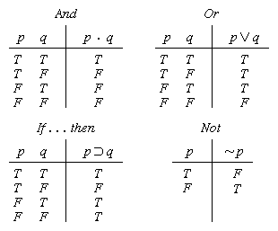
Truth tables

Slide 31

Truth tables II
The five logical connectives:
p | q | p∧q | p∨q | p⊕q | p⇒q | p⇔q
0 | 0 | 0 | 0 | 0 | 1 | 1
0 | 1 | 0 | 1 | 1 | 1 | 0
1 | 0 | 0 | 1 | 1 | 0 | 0
1 | 1 | 1 | 1 | 0 | 1 | 1
A complex sentence:

Slide 32
Semantics
The semantics or meaning of a sentence is just the value true or false: that is, it is as assignment of a truth value to the sentences.
An interpretation for a sentence or group of sentences in an assignment of the truth value to each propositional symbol.

Slide 33
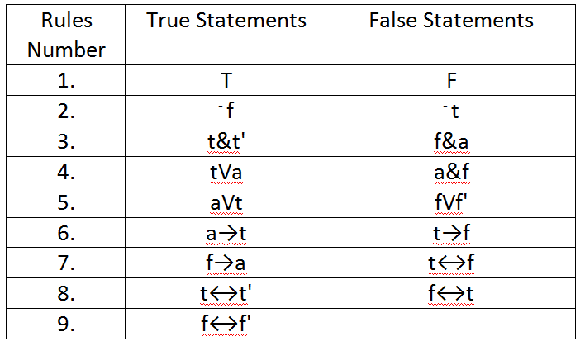


Semantic Rules for statements
Consider t and f' denotes true statements, f and t' denotes false statements, and a is any statement.
T & ~F
$$f∨t′$$
t$⟷t′$

Slide 34
Example
Let I assign true to P , false to Q and false to R in statement ((P & ⁻Q) →R)VQ.
What is the meaning of the statement?
Answer:
Rule 2 gives ⁻Q as true.
Rule 3 gives (P & ⁻Q) as true.
Rule 6 gives (P & ⁻Q) →R as false.
Rule 5 gives the statement ((P & ⁻Q) →R)VQ value as false.

Slide 35
Assignment
Find the meaning of the statement
(⁻PVQ)&R→SV(⁻R&Q)
for each of the interpretations given below.
(a). I₁ : P is true, Q is true, R is false, S is true.
(b). I₂ : P is true, Q is false, R is true, S is true.

Slide 36
Example
Find the meaning of the following statement:
~(P V ~Q) & (R → S) for the interpretation given bellow:
I: P is true, Q is false, R is true and S is false.
Answer:
Rule 2 gives ⁻Q as true.
Rule 4 gives (P V ⁻Q) as true.
Rule 4 gives ~(P V ⁻Q) as false.
Rule 6 gives (R → S) as false.

Slide 37
Example
Find the meaning of the following statement:
~(P V ~Q) & (R → S) for the interpretation given bellow:
I: P is true, Q is false, R is true and S is false.
Answer:
Rule 2 gives ⁻Q as true.
Rule 4 gives (P V ⁻Q) as true.
Rule 4 gives ~(P V ⁻Q) as false.
Rule 6 gives (R → S) as false.
Rule 3 gives the statement ~(P V ~Q) & (R → S) value as false.

Slide 38
Different cases of implication
Consider the proposition p → q
Its converse is the proposition q → p
Its inverse is the proposition ¬p → ¬q
Its contrapositive is the proposition ¬q → ¬p

Slide 39
Constructing Truth Tables
Construct the truth table for the following compound proposition
(( p ∧ q )∨ ¬q )
p | q | p∧q | ¬q | (( p ∧ q )∨ ¬q )
0 | 0 | 0 | 1 | 1
0 | 1 | 0 | 0 | 0
1 | 0 | 0 | 1 | 1
1 | 1 | 1 | 0 | 1

Slide 40
Quick Task
Using truth table prove that are equivalent

Slide 41
Solution
P | Q | P←→Q
f | f | t
f | t | f
t | f | f
t | t | t
P | Q | P→Q | Q→P | (P→Q)&(Q→P)
f | f | t | t | t
f | t | t | f | f
t | f | f | t | f
t | t | t | t | t
Since both have the same truth value under every interpretation,
then they are equivalent

Slide 42
Properties of Statement
Tautology : A compound proposition that is always true, no matter what the truth values of the propositions that occur in it is called a tautology
P V ~P
Contradiction: A compound proposition that is always false is called a contradiction
P & ~P
Contingency: A proposition that is neither a tautology nor a contradiction is a contingency
.
Examples
A simple tautology is p ∨ ¬p
A simple contradiction is p ∧ ¬p

Slide 43
Properties of Statement
Equivalence: Two sentences are equivalent if they have the same truth value under every interpretations.
Logical Consequences: A sentence is a logical consequence of another if it is satisfied by all interpretations which satisfy the first.
A toghtology statement is satisfiable, and a contradictory statement is invalid, but the converse is not necessarily true.

Slide 44
Example: On The above definitions:
.P V ~P is toghtology since every interpretation results in a value of true for (P V ~P ).
P & ~P is a contradiction since every interpretation results in a value of false for (P & ~P).
P and ~(~P) are equivalent since each has the same truth values under every interpretation.
P is a logical consequence of (P & Q) since any interpretation for which (P & Q) is true, P is also true.

Slide 45
Logical Equivalences: Example 1
Show that (Exercise 25 from Rosen)
(p → r) ∨ (q → r) ≡ (p ∧ q) → r
p | q | r | p→ r | q→ r | (p→ r) ∨ (q → r) | p ∧ q | (p ∧ q) → r
0 | 0 | 0
0 | 0 | 1
0 | 1 | 0
0 | 1 | 1
1 | 0 | 0
1 | 0 | 1
1 | 1 | 0
1 | 1 | 1

Slide 46
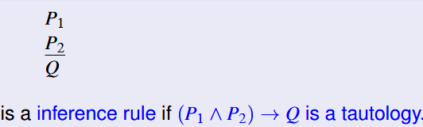
Inference Rules
The inference rules of PL provide the means to perform logical proofs or deductions.
Few Such Rules are as follows:
Modus ponens
Chain Rule

Slide 47
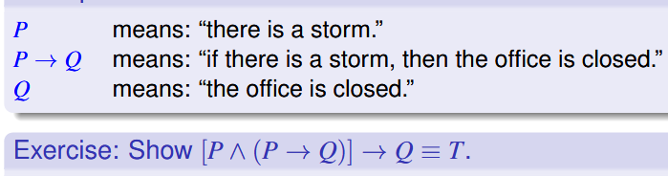
Modus Ponens:
From P and P → Q infer Q. This sometimes written as
P
P → Q
Q

Slide 48
Example For Modus Ponens:
Given: (Joe is a father) And: (Joe is a father) → ( Joe has a child)
Conclude: (Joe has a child)

Slide 49
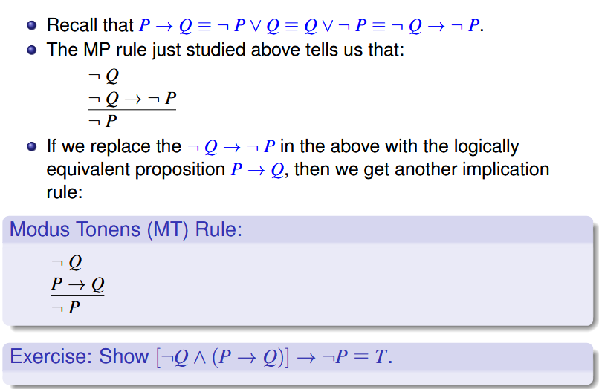

Slide 50
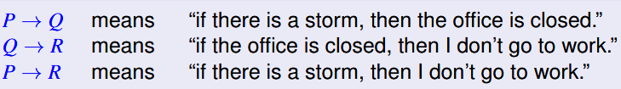
Chain Rule hypothetical Syllogism
Form P → Q and Q→ R, infer P→R.
Or
P → Q
Q → R
P → R

Slide 51
Example for Chain Rule
Given: (programmer likes LISP)→ (programmer hates COBOL)
and : (programmer hates COBOL) → (programmer likes recursion)
Conclude: (programmer likes LISP)→ (programmer likes recursion)
LISP → List Processing
COBOL → Common Business Oriented Programming Language
Prolog → Programming in Logic

Slide 52
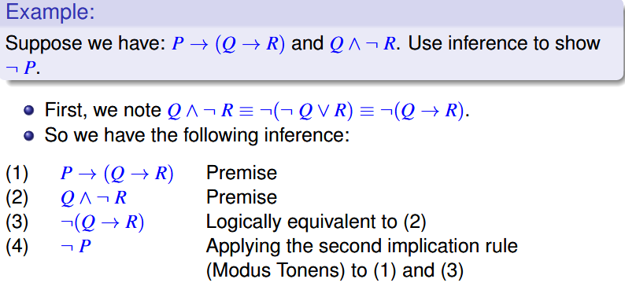
Logical equivalence vs. inference
By using inference rules, we can “prove” the conclusion follows from the premises. In inference, we can always replace a logic formula with another one that is logically equivalent, just as we have seen for the implication rule.

Slide 53
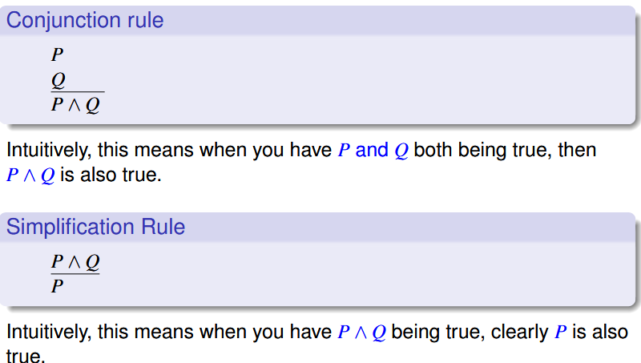
Conjunction and Simplification Rules

Slide 54
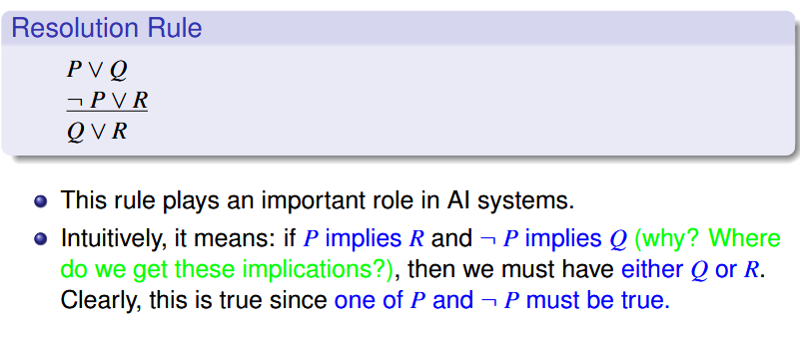
3rd Disjunction rule

Slide 55
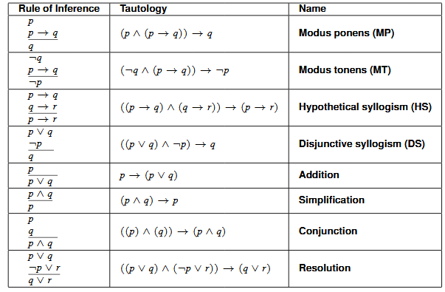
Rules of Inference

Slide 56
Theorem
Theorem 4.1: The sentence s is a logical consequence of s₁ , s₂ , ...... , s_{n} if and only if s₁ & s₂ & s₃ . . . . & s_{n} → s is valid/toghtology.
Proof: Theorem 4.1 can be seen by first noting that if s is a logical consequence of s₁ , s₂ , .......... , s_{n} , then for any interpretation I in which s₁ & s₂ & s₃ , ..... . &s_{n} → s is true.
on the other hand, if s₁ & s₂ & s₃ , .... & s_{n} →s is totologogy, then for any interpretation I if s₁ & s₂ & s₃ , ..... . &s_{n} is true, s is also true.
When s is a logical consequence of the set S = {s₁ , s₂ , ...... , s_{n} } we will also set S logically implies or logically entails S , written Sⱶs .

Slide 57
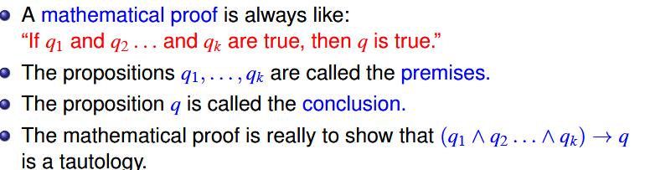
Theorem
Theorem 4.1: The sentence s is a logical consequence of s₁ , s₂ , ...... , s_{n} if and only if s₁ & s₂ & s₃ . . . . & s_{n} → s is valid/toghtology.
To do this, we can either:
1. Directly prove by using logic equivalence
rules, (which will be very long); or
2.Present a valid argument, by using logic inference rules, defined
in the following slide.

Slide 58
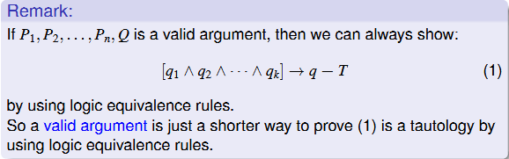
Theorem
Theorem 4.1: The sentence s is a logical consequence of s₁ , s₂ , ...... , s_{n} if and only if s₁ & s₂ & s₃ . . . . & s_{n} → s is valid/toghtology.

Slide 59
Theorem
Theorem 4.2: The sentence s is a logical consequence of s₁ , s₂ , ...... , s_{n} if and only if s₁ & s₂ & s₃ , .... & s_{n} & ~s is inconsistent.
Proof: The proof of theorem 4.2 follows directly from theorem 4.1 since s is a logical consequence of s₁ , s₂ , ...... , s_{n} if if s₁ & s₂ & s₃ , ..... . &s_{n} → s is toghtology , that is, if and only if
~(s₁ & s₂ & s₃ , ..... . &s_{n} → s ) is inconsistent.

Slide 60
Conti …..
But
~(s₁ & s₂ & s₃ , ..... . &s_{n} → s ) = ~(~(s₁ & s₂ & s₃ , ..... . &s_{n} ) V s)
[By Conditional Elimination]
= ~~(s₁ & s₂ & s₃ , ..... . &s_{n} ) & ~s)
[ By De Morgan’s Law]
= s₁ & s₂ & s₃ , ..... . &s_{n} & ~s
When s is a logical consequence of s₁ , s₂ , ...... , s_{n} , the formula s₁ & s₂ & s₃ , ..... . &s_{n} → s is called a theorem, with s is the conclusion.

Slide 61
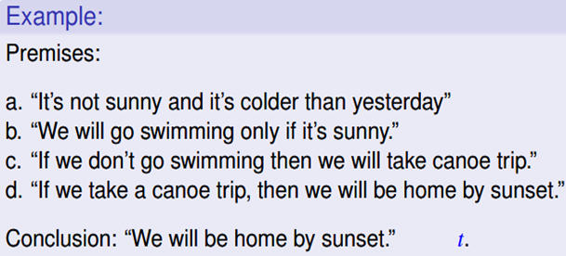
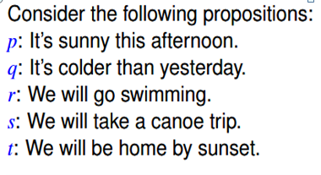

Slide 62
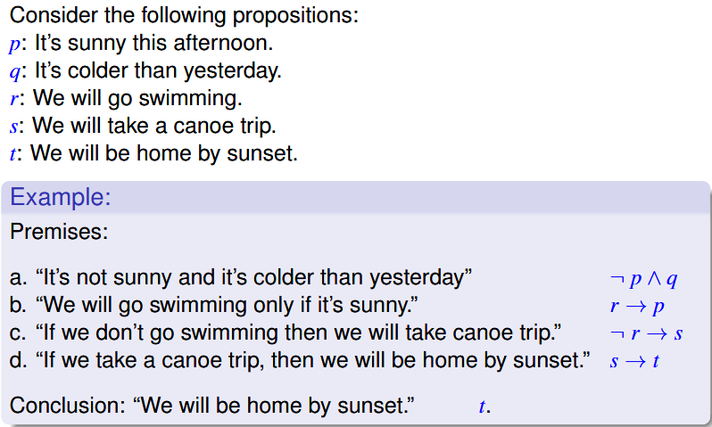

Slide 63
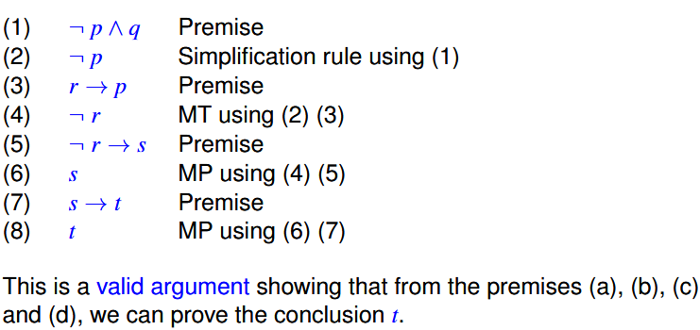

Slide 64
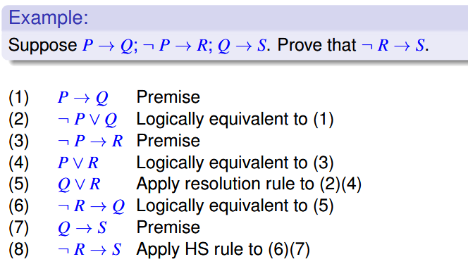

Slide 65
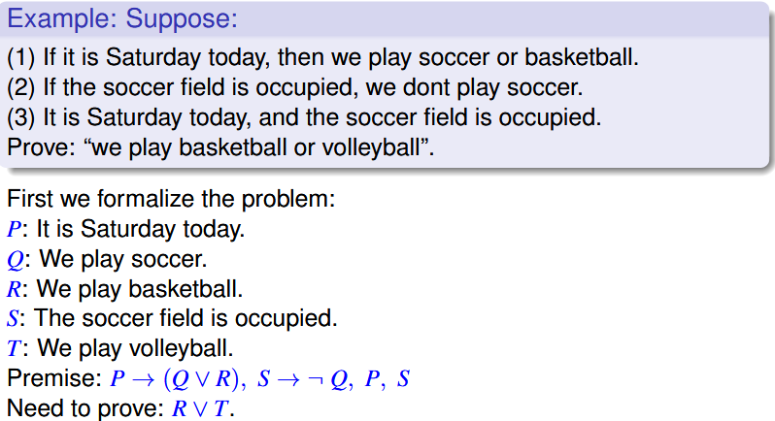

Slide 66
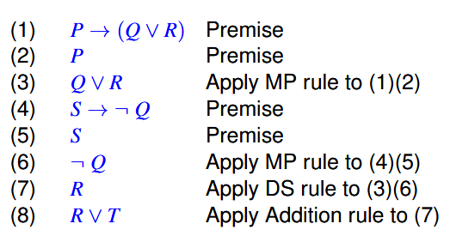

Slide 67
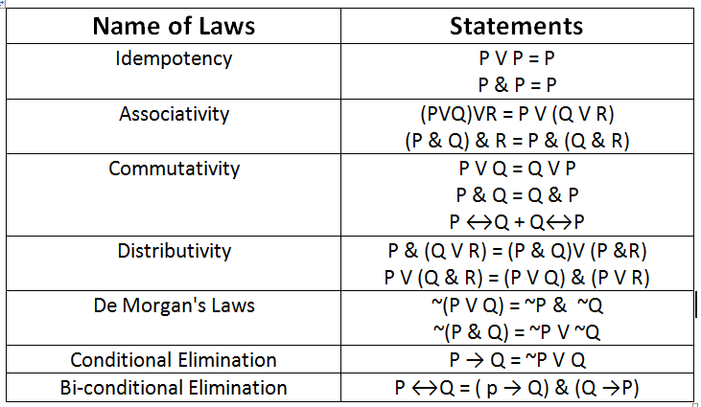
Table 4.2 lists some of the important laws of PL (Some Equivalence Laws)

Slide 68
Example: DeMorgans
Prove that ¬(p∨q) ⇔ (¬p ∧ ¬q)
p q (p∨q) ¬(p∨q) ¬p ¬q (¬p ∧ ¬q)
T T
T F
F T
F F
T F F F F
T F F T F
T F T F F
F T T T T

Slide 69
Example: Distribution
Prove that: p ∨ (q ∧ r) ⇔ (p ∨ q) ∧ (p ∨ r)
p q r q∧r p∨(q∧r) p∨q p∨r (p∨q)∧(p∨r)
T T T T T T T T
T T F F T T T T
T F T F T T T T
T F F F T T T T
F T T T T T T T
F T F F F T F F
F F T F F F T F
F F F F F F F F

Slide 70
Using Logical Equivalences: Example 1
Logical equivalences can be used to construct additional logical equivalences
Example: Show that (p ∧ q) →q is a tautology
Example (Exercise 17)*: Show that ¬(p ↔ q) ≡ (p ↔ ¬q)

Slide 71
Using Logical Equivalences: Example 1
Logical equivalences can be used to construct additional logical equivalences
Example: Show that (p ∧ q) →q is a tautology
0. (p ∧ q) →q
1. ≡ ¬(p ∧ q) ∨ q Implication Law on 0
2. ≡ (¬p ∨ ¬q) ∨ q De Morgan’s Law (1st) on 1
3. ≡ ¬p ∨ (¬q ∨ q) Associative Law on 2
4. ≡ ¬p ∨ 1 Negation Law on 3
5. ≡ 1 Domination Law on 4

Slide 72
Using Logical Equivalences: Example 2
Example (Exercise 17)*: Show that ¬(p ↔ q) ≡ (p ↔ ¬q)
Sometimes it helps to start with the second proposition (p ↔ ¬q)
0. (p ↔ ¬q)
1. ≡ (p → ¬q) ∧ (¬q → p) Equivalence Law on 0
2. ≡ (¬p ∨ ¬q) ∧ (q ∨ p) Implication Law on 1
3. ≡ ¬(¬((¬p ∨ ¬q) ∧ (q ∨ p))) Double negation on 2
4. ≡ ¬(¬(¬p ∨ ¬q) ∨ ¬(q ∨ p)) De Morgan’s Law…
5. ≡ ¬((p ∧ q) ∨ (¬q ∧ ¬p)) De Morgan’s Law
6. ≡ ¬((p ∨ ¬q) ∧ (p ∨ ¬p) ∧ (q ∨ ¬q) ∧ (q ∨ ¬p)) Distribution Law
7. ≡ ¬((p ∨ ¬q) ∧ (q ∨ ¬p)) Identity Law
8. ≡ ¬((q → p ) ∧ (p → q)) Implication Law
9. ≡ ¬(p ↔ q) Equivalence Law
*See Table 8 (p 25) but you are not allowed to use the table for the proof

Slide 73
Using Logical Equivalences: Example 3
Show that ¬(q → p) ∨ (p ∧ q) ≡ q

Slide 74
Using Logical Equivalences: Example 3
Show that ¬(q → p) ∨ (p ∧ q) ≡ q
0. ¬(q → p) ∨ (p ∧ q)
1. ≡ ¬(¬q ∨ p) ∨ (p ∧ q) Implication Law
2. ≡ (q ∧ ¬p) ∨ (p ∧ q) De Morgan’s
& Double negation
3. ≡ (q ∧ ¬p) ∨ (q ∧ p) Commutative Law
4. ≡ q ∧ (¬p ∨ p) Distributive Law
5. ≡ q ∧ 1 Identity Law
≡ q Identity Law

Slide 75
First Order Periodic Logic
PL dose not allow us to make generalized statement about classes of similar object.
FOPL is a generalization of PL
FOPL was developed to extend the expressiveness of PL
The syntax for FOPL, like PL, is determined by the allowable symbols and rules of combination.
The semantics of FOPL are determined by interpretations assigned to predicates, rather than propositions.
All Student in CS must take Pascal
John is a CS major
It is not possible in PL to conclude that john must take Pascal

Slide 76
Logical connectives
Quantifier
Predicates
Variables
Constants
Functions

Slide 77
Syntax Of FOPL
In FOP statement from the natural language are translated into
symbolic structure comprised of
Connectives: ~, &, V,
Quantifiers:
Predicate: P,Q,R, EQUALS, MARRID
Predicates are also referred to as atomic formula or atoms or literal
Constants: a, b, c, 3.5,-21, flight-102
Variables : aircraft-type, x,y,z
Functions: f(), g(), h(), father-of()
f(t₁,t₂,….,t_{n}) is a n-ary function where t_{i} are terms(constants, variables or functions)

Slide 78
Syntax of FOPL
The symbols and rules of combination permitted in FOPL are defined as follows:
Connectives: There are five connective symbols:
~(not or negation)
& (and or conjunction)
V (or or inclusive disjunction)
→ (implication)
↔ (equivalence or if and only if).

Slide 79
Syntax of FOPL Quantifiers
Universal quantification
(∀x)P(x) means that P holds for all values of x in the domain associated with that variable
E.g., (∀x) dolphin(x) → mammal(x)
Existential quantification
(∃ x)P(x) means that P holds for some value of x in the domain associated with that variable
E.g., (∃ x) mammal(x) ∧ lays-eggs(x)
Permits one to make a statement about some object without naming it
The two quantifier symbols are ∃ ( existential quantification) and ∀ (universal quantification).
Where (∃x) means for some x or there is an x . and (∀x) means for all x.
When more than one variable is being quantified by the same quantifier, such as, (∀x) (∀y) (∀z), we abbreviate with a single quantifier and drop the parentheses to get ∀xyz.

Slide 80
Quantifiers
Universal quantifiers are often used with “implies” to form “rules”:
(∀x) student(x) → smart(x) means “All students are smart”
Universal quantification is rarely used to make blanket statements about every individual in the world:
(∀x)student(x)∧smart(x) means “Everyone in the world is a student and is smart”
Existential quantifiers are usually used with “and” to specify a list of properties about an individual:
(∃x) student(x) ∧ smart(x) means “There is a student who is smart”
A common mistake is to represent this English sentence as the FOL sentence:
(∃x) student(x) → smart(x)
But what happens when there is a person who is not a student?

Slide 81
Quantifier Scope
Switching the order of universal quantifiers does not change the meaning:
(∀x)(∀y)P(x,y) ↔ (∀y)(∀x) P(x,y)
Similarly, you can switch the order of existential quantifiers:
(∃x)(∃y)P(x,y) ↔ (∃y)(∃x) P(x,y)
Switching the order of universals and existentials does change meaning:
Everyone likes someone: (∀x)(∃y) likes(x,y)
Someone is liked by everyone: (∃y)(∀x) likes(x,y)

Slide 82
Connections between All and Exists
We can relate sentences involving ∀ and ∃ using De Morgan’s laws:
(∀x) ¬P(x) ↔ ¬(∃x) P(x)
¬(∀x) P ↔ (∃x) ¬P(x)
(∀x) P(x) ↔ ¬ (∃x) ¬P(x)
(∃x) P(x) ↔ ¬(∀x) ¬P(x)

Slide 83
Syntax of FOPL
Predicates: Predicate symbols denote relations or functional mappings from the elements of a domain D to the values true or false.
Capital letters and capitalized words such as P, Q, R, EQUAL, and MARRIED are used to represent predicates.
Like functions, predicates may have n (n ≥ 0) terms for arguments written as P(t₁, t₂, t₃, .. .. .., t_{n})
Where the terms t_{i} , i =1 , 2, 3, .. .. .. , n are defined over some domain.
A 0-ary predicate is a proposition, that is, a constant predicate.
Constants, variables, and functions are referred to as terms, and predicates are referred to as atomic formulas or atoms for short.

Slide 84
Syntax of FOPL
Constants: Constants are fixed-value terms that belong to a given domain of discourse.
They are denoted by numbers, words, and small letters near the beginning of the alphabet.
Examples: a , b , c , 5.256, -67, -75.65 , flight-305, john, , Marina, etc.
Variables: Variables are terms that can assume different values over a given domain.
They are denoted by words and small letters near the end of the alphabet.
Examples: aircraft-type, individuals, x, y, and z.

Slide 85
Syntax of FOPL
Functions:
which are a subset of relations where there is only one “value” for any given “input”
Function symbols denote relations defined on a domain D. They map n elements (n≥0) to a single element of the domain.
Symbols f , g, & h, and words such as father-of , or age-of, represent functions.
An n place (n-ary) function is written as f(t₁, t₂, t₃, .. .. .. t_{n}) where the t_{i} are terms (constants, variables, or functions) defined over some domain. A 0-ary function is a constant.
Brother-of, bigger-than, outside, part-of, has-color, occurs-after, owns, visits, precedes, ..

Slide 86
Syntax of FOPL
An atomic formula is a wffs (well-formed formulas) .
If P and Q are wffs, then ~P, P & Q, P V Q, P
P↔Q, ∀x P(x), and ∃x P(x) are wffs.
Wffs are formed only by applying the above rules a finite number of times.
The above rules state that all wffs are formed from atomic formulas and the proper application of quantifiers and logical connections.

Slide 87
Syntax of FOPL
Some examples of valid wffs are
MAN(john)
PILOT(father-of(bill))
∃ xyz((FATHER(x,y)&FATHER(y,z)) →GRANDFATHER(x,z))
∀x NUMBER(x) →(∃y GREATER-THAN(y,x))

Slide 88
Quantified inference rules
Rules of inference start to be more useful when applied to quantified
statements.
Rules for quantified statements:
Universal instantiation
∀x P(x) ∴ P(C)
Universal generalization
P(C) ∧ P(B) … ∴ ∀x P(x)
Existential instantiation
∃x P(x) ∴P(C) ← skolem constant F
Existential generalization
P(C) ∴ ∃x P(x)

Slide 89
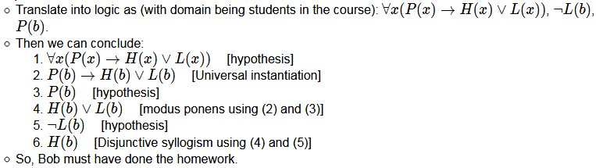
Quantified inference rules
Prove things that are maybe less obvious. e.g.
“Students who pass the course either do the homework or attend lecture;”
“Bob did not attend every lecture;” “Bob passed the course.”

Slide 90

Quantified inference rules
e.g. “Bob failed the course, but attended every lecture;” “everyone who did the homework every week passed the course;”
“if a student passed the course, then they did some of the homework.”
We want to conclude that not every student submitted every homework assignment.
Translate into logic as (domain for s being students in the course and w being weeks of the semester):

Slide 91
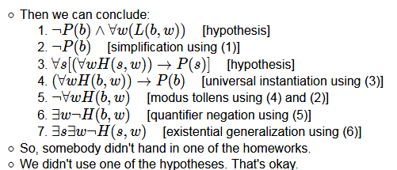
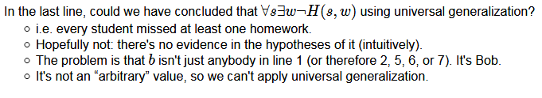
Quantified inference rules

Slide 92
Translating English to FOL
Every gardener likes the sun.
∀x gardener(x) → likes(x,Sun)
You can fool some of the people all of the time.
∃x ∀t person(x) ∧time(t) → can-fool(x,t)
You can fool all of the people some of the time.
∀x ∃t (person(x) → time(t) ∧can-fool(x,t))
All purple mushrooms are poisonous.
∀x (mushroom(x) ∧ purple(x)) → poisonous(x)
No purple mushroom is poisonous.
∀x (mushroom(x) ∧ purple(x)) → ¬poisonous(x)
Clinton is not tall.
¬tall(Clinton)
Equivalent

Slide 93
Syntax of FOPL
Some examples of statements that are not wffs are:
∀P P(x)→Q(x)
/* Universal quantification is applied to the predicate P(x). This is invalid in FOPL. */
MAN(~john)
/*The expression is invalid since the term John, a constant, is negated. */
father-of(Q(x))
/* The expression is invalid due to it is function with a predicate argument. */
MARRIED(MAN,WOMAN)
/* The expression fails since it is predicate with two predicate arguments.*/

Slide 94
Translating between English and Logic Notation
E1: All employees earning $1400 or more per year pay taxes.
E2: Some employees are sick today
E3: No employee earns more than the precedent

Slide 95
FOPL
E(x) => x is an employee
P(x) => x is president
i(x) => income of x
GE(u,v) => u is grater than v
S(x) => x is sick today
T(x) => x pays tax

Slide 96
FOPL
E1: All employees earning $1400 or more per year pay taxes.
E1’:
E(x) => x is an employee
P(x) => x is president
i(x) => income of x
GE(u,v) => u is grater than v
S(x) => x is sick today
T(x) => x pays tax

Slide 97
FOPL
E2: Some employees are sick today
E2’:
E(x) => x is an employee
P(x) => x is president
i(x) => income of x
GE(u,v) => u is grater than v
S(x) => x is sick today
T(x) => x pays tax

Slide 98
FOPL
E3: No employee earns more than the precedent
E3’:
E(x) => x is an employee
P(x) => x is president
i(x) => income of x
GE(u,v) => u is grater than v
S(x) => x is sick today
T(x) => x pays tax

Slide 99
Assignment
Marcus was a man.
Marcus was a Pompeian.
All Pompeians were Romans.
Caesar was a ruler.
All Pompeians were either loyal to Caesar or hated him.
Every one is loyal to someone.
People only try to assassinate rulers they are not loyal to.
Marcus tried to assassinate Caesar.

Slide 100
Assignment
Marcus was a man.
Man(Marcus)
Marcus was a Pompeian.
Pompeian(Marcus)
All Pompeians were Romans.
∀x( Pompeian(x) → Roman(x) )

Slide 101
Assignment
Caesar was a ruler.
Ruler(Caesar)
All Pompeians were either loyal to Caesar or hated him. ( inclusive Or)
∀x Pompeian(x) → Loyalto(x, Caesar) ∨ Hate(x, Caesar)

Slide 102
Assignment
Every one is loyal to someone.
∀x∃y: Loyalto(x, y)
People only try to assassinate rulers they are not loyal to.
∀x∀y Person(x) ∧ Ruler(y) ∧ Tryassassinate(x, y) → ~Loyalto(x, y)

Slide 103
Assignment
Marcus tried to assassinate Caesar.
Tryassassinate(Marcus, Caesar)

Slide 104
Conversion to Clausal Form
Resolution is one of the method by which we can do “mechanical inference” programmatically
Resolution requires that all statement be converted into normalized clausal form.
A formula is in conjunctive normal form (CNF) or clausal normal form if it is a conjunction of one or more clauses, where a clause is a disjunction of literals; otherwise put, it is an AND of ORs.

Slide 105
We define Clause as the disjunction of a number of literal
A ground clause is one in which no variable occur in the expression.
A horn Clause is a clause with at most one positive literal.

Slide 106
Conversion Of FOPL sentence to Clausal Form
Step 1: Eliminate all implication (→) and equivalency (←→) connectives
(P → Q ≡ ~P ∨ Q, P ←→ Q ≡ (~P ∨ Q) & (~Q ∨ P)
Step 2: Move all negations (~) so that they immediately precedes an atom
(use P in place of ~(~P) and ∃x ~P(x) in place of ~∀x P(x)

Slide 107
Conversion Of FOPL sentence to Clausal Form
Step 3: Rename variables, if necessary, so that all quantifiers have different variable assignments
∀x ( P(x) → ∃x Q(x) ) should be renamed as ∀x ( P(x) → ∃y Q(y) )
Step 4: Skolemize all existential quantifiers
Step 5: Move all universal quantifiers to the left of the expression and put the expression into CNF form

Slide 108
Conversion Of FOPL sentence to Clausal Form
Step 6: Eliminate all Universal quantifier and conjunctions since they are retained implicitly. ( as ∀x P(x) ≡ P(x) ).
Step 7: The resulting expressions are clauses and the set of such expressions is said to be is clausal form

Slide 109
Conversion to Clause Form
Eliminate →.
P → Q ≡ ¬P ∨ Q
Reduce the scope of each ¬ to a single term.
¬(P ∨ Q) ≡ ¬P ∧ ¬Q
¬(P ∧ Q) ≡ ¬P ∨ ¬Q
¬∀x: P ≡ ∃x: ¬P
¬∃x: p ≡ ∀x: ¬P
¬¬ P ≡ P
Standardize variables so that each quantifier binds a unique variable.
(∀x P(x)) ∨ (∃x Q(x)) ≡ (∀x P(x)) ∨ (∃y Q(y))

Slide 110
Conversion to Clause Form
Move all quantifiers to the left without changing their relative order.
(∀xP(x)) ∨ (∃y Q(y)) ≡ ∀x∃y(P(x) ∨ (Q(y))
Eliminate ∃ (Skolemization).
∃x P(x) ≡ P(c) Skolem constant
∀x:∃y P(x, y) ≡ ∀xP(x, f(x)) Skolem function
Drop ∀.
∀xP(x) ≡ P(x)
Convert the formula into a conjunction of disjuncts.
(P ∧ Q) ∨ R ≡ (P ∨ R) ∧ (Q ∨ R)
8. Create a separate clause corresponding to each conjunct.
9. Standardize apart the variables in the set of obtained clauses.

Slide 111
Example
∃x ∀y ∀z P(f(x), y, z) → (∃u Q( x, u) & ∃v R( y, v))
∃x ∀y( ~ ∀z P(f(x), y, z) ∨ (∃u Q( x, u) & ∃v R( y, v)))
∀y( ∃z~ P(f(c), y, z) ∨ (∃u Q( x, u) & ∃v R( y, v)))
∀y( ~ P(f(c), y, g(y)) ∨ ( Q( c, h(y)) & R( y, i(y))))
A ∨ B & C
(~ P(f(c), y, g(y)) ∨ ( Q( c, h(y)) )& ( ~ P(f(c), y, g(y)) ∨ R( y, i(y) )
(A ∨ B) & ( A ∨ C )

